Slide 1

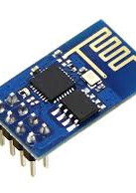
PROJECT – 1 The Problem Statement… Temperature and Humidity Monitoring over Thing Speak using Arduino UNO and ESP8266

Slide 2
Introduction
In this project, we are using the DHT11 sensor for sending Temperature and Humidity data to Thingspeak using Arduino and ESP8266. By this method, we can monitor our DHT11 sensor’s temperature and humidity data over the internet using the ThingSpeak server. And we can view the logged data and graph overtime on the Thingspeak website.
Here Arduino Uno reads the current temperature and humidity data from DHT11 and sends it to the ThingSpeak server for live monitoring from anywhere in the world. We used ThingSpeak with Raspberry Pi and ESP32 to upload the data on the cloud. ThingSpeak is an open data platform for monitoring your data online where you can set the data as private or public according to your choice. ThingSpeak takes a minimum of 15 seconds to update your readings.

Slide 3
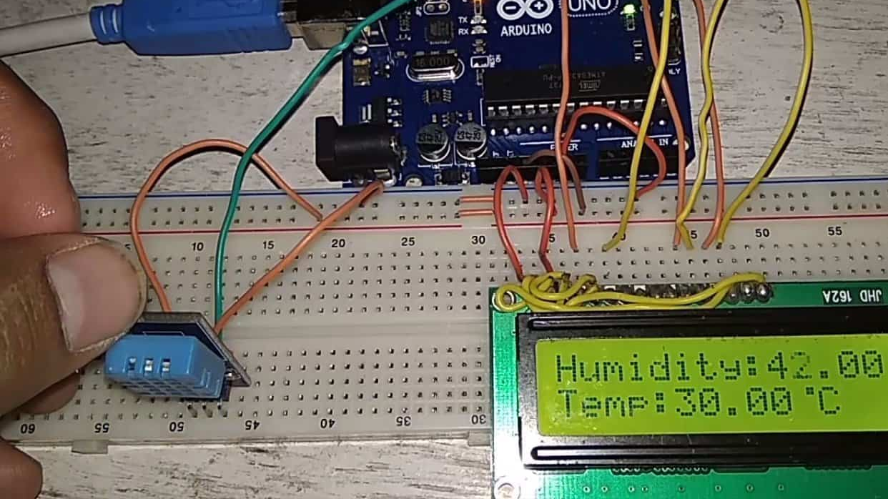
On-board display: An LCD screen can be connected to the Arduino to display the current temperature and humidity readings in real-time.

Slide 4
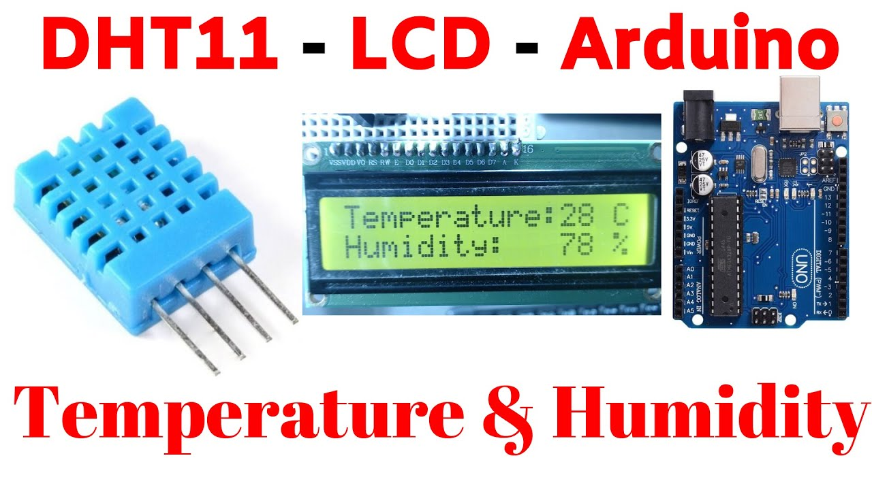
Tools :
Components Required
Arduino Uno
ESP8266 WiFi Module
DHT11 Sensor
Jumper Wires
LCD Dipsplay

Slide 5
Project Description
Proposed Solution:
This project constructs an environmental data logger using an Arduino microcontroller board. The system utilizes sensors to measure ambient temperature and humidity. The sensor readings, initially in analog voltage format, are processed by the Arduino and converted into standard units of Celsius for temperature and percent relative humidity. The project offers functionalities for both local and remote monitoring.
Remote Monitoring:
The Arduino communicates wirelessly with a web platform called Thingspeak via an ESP8266 Wi-Fi module. This enables the transmission of collected temperature and humidity data to Thingspeak. Users can then access this data remotely from any device with an internet connection, allowing for convenient monitoring and analysis of environmental conditions over time. This remote access empowers users to make informed decisions regarding potential adjustments to their environment based on the collected data.

Slide 6
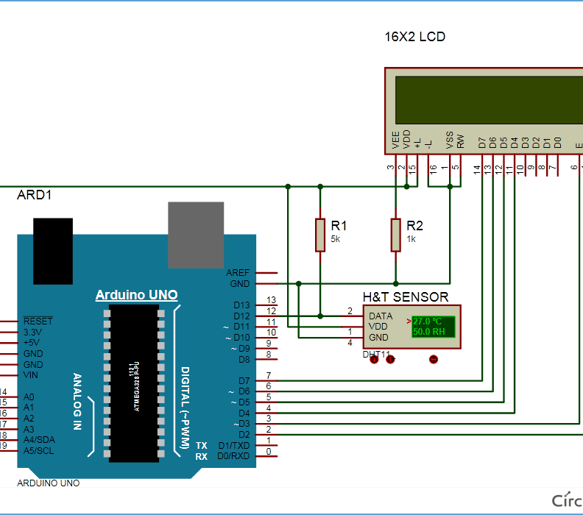
Circuit Diagram and Explanation
A liquid crystal display is used for displaying temperature and humidity which is directly connected to Arduino in 4-bit mode. Pins of LCD namely RS, EN, D4, D5, D6 and D7 are connected to Arduino digital pin number 2, 3, 4, 5, 6 and 7. And a DHT11 sensor module is also connected to digital pin 12 of Arduino with a 5k pull-up resistor.

Slide 7
The Project Implementation : Steps
2. Software Configuration:
Install the necessary libraries for the DHT sensor and the I2C LCD display in your Arduino IDE.
Set up the ESP8266 to connect to your Wi-Fi network.
Configure the Thingspeak platform to receive data from your Arduino.
3. Arduino Code:
Read temperature and humidity data from the DHT sensor.
Display the data on the LCD screen.
Send the data to Thingspeak using the ESP8266.
1. Hardware Setup:
You’ll need an Arduino UNO or a similar board.
Connect a DHT11 or DHT22 temperature and humidity sensor to the Arduino.
Wire up a 16x2 LCD display (I2C) to the Arduino.
Use an ESP8266 Wi-Fi module for wireless communication.

Slide 8
S.NO. | Pin Name | Arduino Pin
1 | ESP8266 VCC | 3.3V
2 | ESP8266 RST | 3.3V
3 | ESP8266 CH-PD | 3.3V
4 | ESP8266 RX | TX
5 | ESP8266 TX | RX
6 | ESP8266 GND | GND
7 | DHT-11 VCC | 5V
8 | DHT-11 Data | 5
9 | DHT-11 GND | GND
Connections Pins :

Slide 9
Temperature and Humidity Monitoring over ThingSpeak using Arduino UNO and ESP8266
In this project, we are using the DHT11 sensor for sending Temperature and Humidity data to Thingspeak using Arduino and ESP8266. By this method, we can monitor our DHT11 sensor’s temperature and humidity data over the internet using the ThingSpeak IoT server. And we can view the logged data and graph overtime on the Thingspeak website.
Here Arduino Uno reads the current temperature and humidity data from DHT11 and sends it to the ThingSpeak server for live monitoring from anywhere in the world. We previously used ThingSpeak with Raspberry Pi and ESP32 to upload the data on the cloud.
ThingSpeak is an open data platform for monitoring your data online where you can set the data as private or public according to your choice. ThingSpeak takes a minimum of 15 seconds to update your readings.

Slide 10
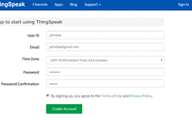
Step 1: ThingSpeak Setup for Temperature and Humidity Monitoring .
For creating your channel on Thing speak, you first need to Sign up on Thing speak. In case if you already have an account on Things peak, just sign in using your id and password. For creating your account go to www.thinspeak.com

Slide 11



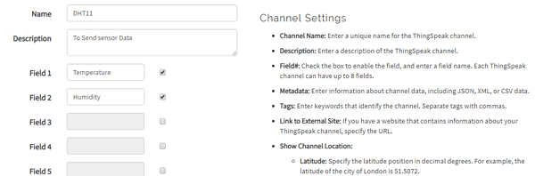

Step 2: Create a Channel for Your Data Once you Sign in after your account verification, Create a new channel by clicking “New Channel” button
After clicking on “New Channel”, enter the Name and Description of the data you want to upload on this channel. For example, I am sending my DHT11 sensor data, so I named it DHT11 data.
Enter the name of your data ‘Temperature’ in Field1 and ‘Humidity’ in Field2.
After this, click on the save channel button to save your details.

Slide 12
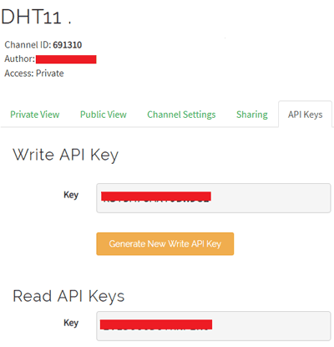
Step 3: API Key
To send data to Thingspeak, we need a unique API key, which we will use later in our code to upload our sensor data to Thingspeak Website.
Click on “API Keys” button to get your unique API key for uploading your sensor data.

Slide 13
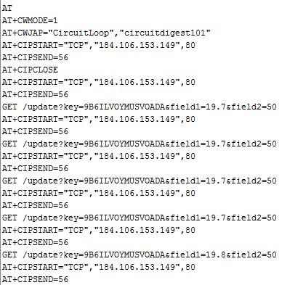
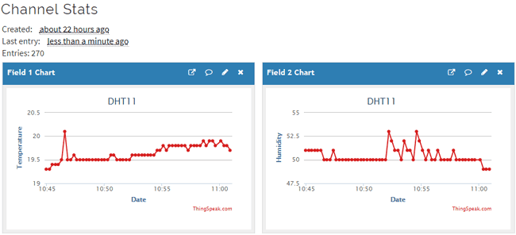
Programming Arduino for Sending data to ThingSpeak To program Arduino, open Arduino IDE and choose the correct board and port from the ‘tool’ menu.
Upload it in Arduino UNO. If you successfully upload your program, Serial monitor will look like this:
After this navigate to your Thingspeak page and open your channel at Thingspeak and output will be shown as below:
we have successfully monitored Temperature and Humidity data over ThingSpeak using Arudino an ESP32.

Slide 14
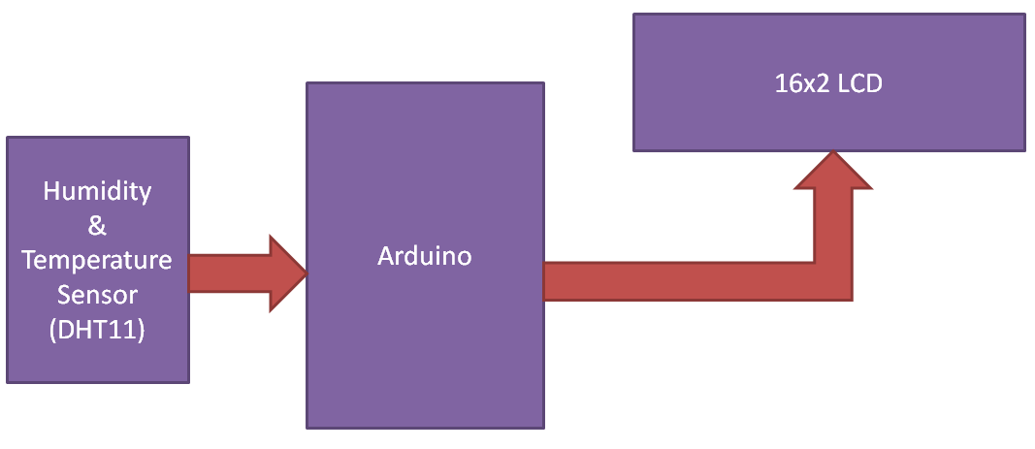
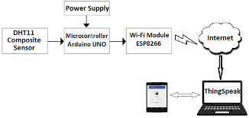
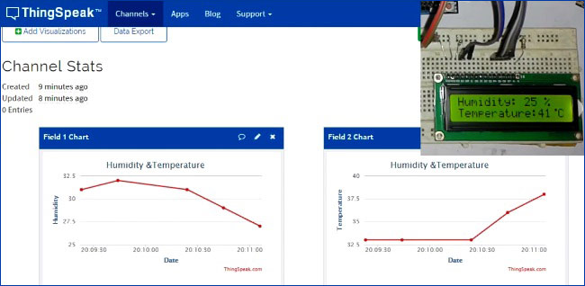
DHT11 Humidity + Temperature Sensor with 16x2 LCD display + ThingSpeak web Platform

Slide 15
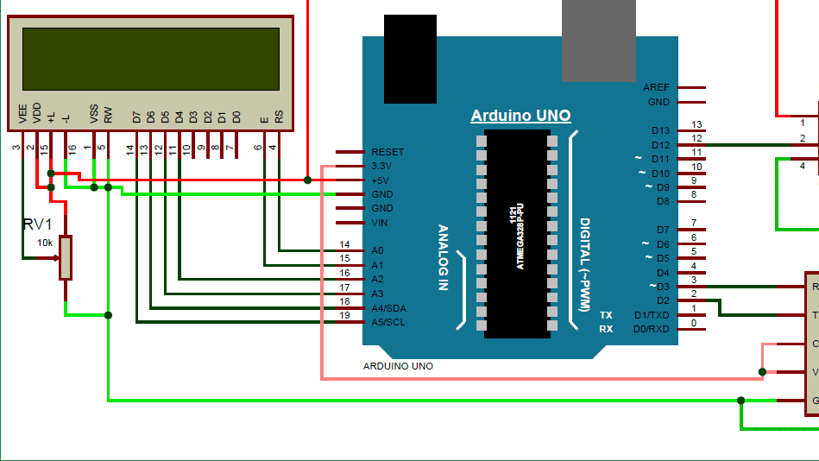
The Embedded System Capstone Project Thank & Regards Potla Sai Kumar Potula Naresh Kumar

